Slide 1
Let’s Microservices
By
Subrahmanyam Devarakonda

Slide 2
Monolithic Applications
1

Slide 3
What’s wrong with Monolithic’s?
The whole application is packaged into a single artifact.
Any small change within the application would need a need complete makeover.
Scaling the application to cater over the planned capacity would grow in complexity with the size of the application.
Its tough to build application architecture with varied computation needs.
2
© Please be shameless to copy any slide you need 😁
Notes:
The artifact sizes keep growing as the application functionality evolves
Every node in a deployment topology would ideally have to be of the same computation power
Deployment rollback would ideally bring the complete application back to the previous best known state
Any small change in the application would have undergo the complete lifecycle of all the quality checks and deployment across.
The other big challenge would be is session stickiness. (Session stickiness is the concept is re-routing a request back to the same node in a cluster served every time).
The only option left to scale the application would be in terms of infrastructure in terms of computation or slicing the application into modules.

Slide 4
Microservices Strategies/Mindset
3
Microservices
Frameworks
Virtualization
Vs
Containerization
Vs
&
Paas + IaaS
© Please be shameless to copy any slide you need 😁

Slide 5
Other Microservices Strategies Attempted
4
SOA
Vs
OSGi
© Please be shameless to copy any slide you need 😁
Notes:
SOA – Service Oriented Architecture
It has been one of the premier attempts towards modularization of software components, though never attempted at smaller scale.
It has more been associated with a Service Bus design pattern, which has been more useful in orchestrating larger services in a system using various protocols like SOAP, JMS, JDBC, Mail, STOMP, HTTP, HTTPS and off-late REST using XML and JSON transformation techniques.
This has been more used in offline processing systems like Order Processing Systems, Business Rule Management Systems where more of a workflow kind-of processing is required.
OSGi - Open Service Gateway Initiative
OSGi has been what the missing piece of Java was, bringing modularity into building systems using the JVM.
The JAR has been pretty much Java’s answer to modularity, but has failed due to various factors.
Every JAR or CLASS in a JAR is loaded by a ClassLoader, which is one of the key constructs in Java.
Java’s way of Classloading has been the real factor of its success and failure too. Success because it achieves immense speeds while loading the class, but clogs up the Garbage Collector while unloading the classes.
This is where OSGi steps where Java loads classes using a Heirarchical Classloading technique, OSGi uses a Peer Classloading technique and believes classes to be more of Immutable nature over Mutable.

Slide 6
Virtualization
According to Wikipedia
In computing, virtualization refers to the act of creating a virtual (rather than actual) version of something, including virtual computer hardware platforms, storage devices, and computer network resources. Virtualization began in the 1960s, as a method of logically dividing the system resources provided by mainframe computers between different applications. Since then, the meaning of the term has broadened.
5
https://en.wikipedia.org/wiki/Virtualization
© Please be shameless to copy any slide you need 😁

Slide 7
Virtualization
6
© Please be shameless to copy any slide you need 😁

Slide 8
Containerization
According to Wikipedia
Operating-system-level virtualization, also known as containerization, refers to an operating system feature in which the kernel allows the existence of multiple isolated user-space instances. Such instances, called containers, partitions, virtualization engines (VEs) or jails (FreeBSD jail or chroot jail), may look like real computers from the point of view of programs running in them. A computer program running on an ordinary operating system can see all resources (connected devices, files and folders, network shares, CPU power, quantifiable hardware capabilities) of that computer. However, programs running inside a container can only see the container's contents and devices assigned to the container.On Unix-like operating systems, this feature can be seen as an advanced implementation of the standard chroot mechanism, which changes the apparent root folder for the current running process and its children. In addition to isolation mechanisms, the kernel often provides resource-management features to limit the impact of one container's activities on other containers.
7
https://en.wikipedia.org/wiki/Operating-system-level_virtualization
© Please be shameless to copy any slide you need 😁

Slide 9
Containerization
8
© Please be shameless to copy any slide you need 😁

Slide 10
Characteristics of Microservices
Loose Coupling
Technology Diversity
Fault Tolerance
9
High Cohesion
Scalability
Ease of Deployment
© Please be shameless to copy any slide you need 😁
Notes:
Loose Coupling - Ideally, you want the services to have little to no dependence amongst one another. Services should be changable and deployable independently, without requiring changes to other parts of the system. Services must expose only the information that is absolutely necessary in order to prevent the apps that consume their data from binding too tightly to them. This makes it easier to roll out changes in the future.
High Cohesion - High Cohesion can be thought of as a corollary to Loose Coupling. Cohesion refers to the idea that all the logic pertaining a particular entity in the system should be bundled together in a single place. This makes it easier to modify the behavior of a portion of the system, since it minimizes the number of places where code needs to be updated.
Technology Diversity - As your application grows in size, so do the number of features it implements and by extension, the number of technological requirements imposed on your system. For example, some parts of your application may demand a specific library written in a specific language which just happens to be the right tool for it. Parts of your application may benefit from the statically typed, secure nature of Java. While other portions may be less demanding. Similarly, the optimal database may very well vary across the application.
Fault Tolerance - The idea of fault tolerance is strongly related to the concept of loose coupling discussed previously. Teams should focus on making each service as independent as possible. This ensures that if one service goes down, it doesn’t affect the other services (except for the ones immediately depending on it). As an end user, your experience may be degraded and limited, but the application should still remain functional. This is, in most cases, far better than crashing the entire application.
Scalability - The issue of scalability is an immensely important one for a fast growing company. When you have a single gigantic application, not all parts of it are equally load intensive. Some may be responsible for more passive, mundane things such as serving static information, while others may be more intensive, requiring a lot of database interaction and/or computing power. The problem with a monolithic codebase, then, is that regardless of the different types of operations it’s conducting, you need to scale the entire application up and down based on need. Since this isn’t an accurate representation of the actual demands on your system, it leads to huge amounts of wasted computing power and resources. This is one of the issues microservices attempt to solve. Because functionality is separated into different “boxes”, each box can be scaled up or down independently, without affecting the rest of the system.
Ease of deployment - Lastly, lets talk a little bit about how deploying these services would work. Given the sheer number of services being deployed, this may seem a bit like a counter argument at first. However, the key thing to remember is that any change in the behavior of a particular part of the application usually requires a change in one and preferably only one part of the application, isolated away into a microservice in this case. When you have a small change, this difference boils down to redeploying a small service versus redeploying a million-line application. In practice, monolithic applications are seldom redeployed at that rate. As a result changes usually build up between releases, leading to bigger, more comprehensive releases. The sheer number of changes being deployed could itself be a potential risk.

Slide 11
The estore monolithic architecture
Catalog Service
Catalog Repo
10
CLIENT
User Service
User Repo
DB
Order Service
Order Repo
UI
Service Layer
Repo Layer
© Please be shameless to copy any slide you need 😁

Slide 12
The estore microservice architecture
Catalog Service
DB
11
CLIENT
User Service
DB
UI
Order Service
DB
© Please be shameless to copy any slide you need 😁

Slide 13
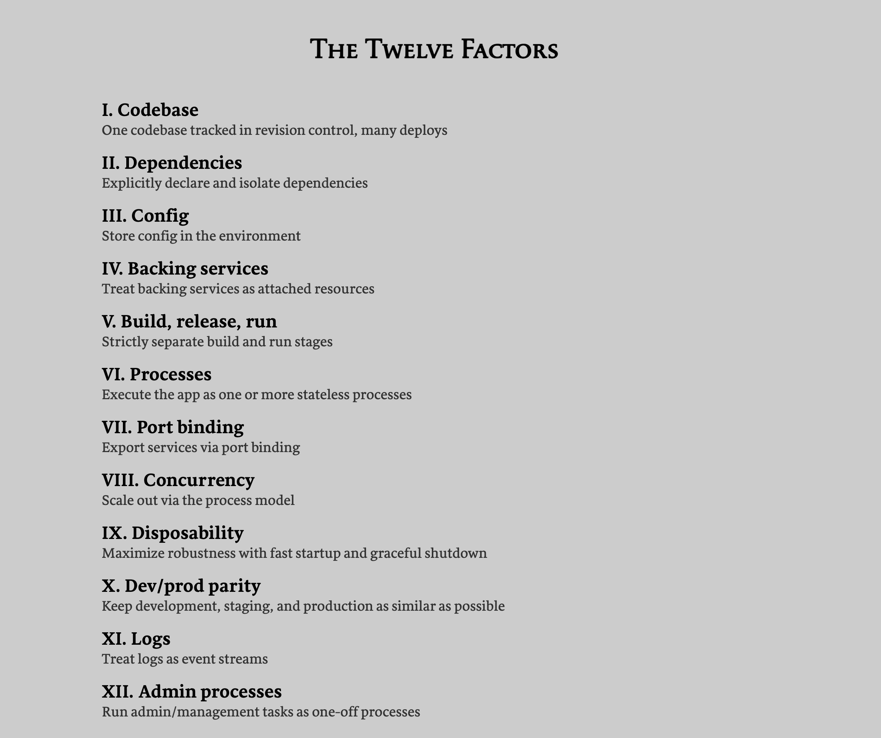
The 12 factors of microservice architecture
https://12factor.net/
12
© Please be shameless to copy any slide you need 😁

Slide 14
The estore cloud microservice architecture
API Gateway
Catalog Service
DB
12
CLIENT
User Service
DB
Config Service
UI
Discovery Service
Order Service
DB
© Please be shameless to copy any slide you need 😁

Slide 15
Spring Cloud
Spring Cloud provides tools for developers to quickly build some of the common patterns in distributed systems (e.g. configuration management, service discovery, circuit breakers, intelligent routing, micro-proxy, control bus, one-time tokens, global locks, leadership election, distributed sessions, cluster state). Coordination of distributed systems leads to boiler plate patterns, and using Spring Cloud developers can quickly stand up services and applications that implement those patterns. They will work well in any distributed environment, including the developer’s own laptop, bare metal data centres, and managed platforms such as Cloud Foundry.
13
https://spring.io/projects/spring-cloud
© Please be shameless to copy any slide you need 😁

Slide 16
Commercial Iaas, Paas and Saas Platforms
14
© Please be shameless to copy any slide you need 😁

Slide 17
J2EE Stack
15
© Please be shameless to copy any slide you need 😁

Slide 18
RoR Stack
16
© Please be shameless to copy any slide you need 😁

Slide 19
NodeJS Stack
17
© Please be shameless to copy any slide you need 😁

Slide 20
CQRS Microservice Architecture
18
© Please be shameless to copy any slide you need 😁

Slide 21
Event Drive Microservice Architecture using Spring Cloud
19
© Please be shameless to copy any slide you need 😁

